Slide 1
Approaching Easter Week 1 PAUSE

Slide 2
Then Jesus was led by the Spirit into the wilderness to be tempted by the devil. After fasting forty days and forty nights, he was hungry. The tempter came to him and said, “If you are the Son of God, tell these stones to become bread.” Jesus answered, “It is written: ‘Man shall not live on bread alone, but on every word that comes from the mouth of God.’” Then the devil took him to the holy city and had him stand on the highest point of the temple. “If you are the Son of God,” he said, “throw yourself down. For it is written: “‘He will command his angels concerning you, and they will lift you up in their hands, so that you will not strike your foot against a stone.’” Jesus answered him, “It is also written: ‘Do not put the Lord your God to the test.’” Again, the devil took him to a very high mountain and showed him all the kingdoms of the world and their splendor. “All this I will give you,” he said, “if you will bow down and worship me.” Jesus said to him, “Away from me, Satan! For it is written: ‘Worship the Lord your God, and serve him only.’” Then the devil left him, and angels came and attended him. Matthew Ch.4:1–11(NIV)

Slide 3
As they approached Jerusalem and came to Bethphage on the Mount of Olives, Jesus sent two disciples, saying to them, “Go to the village ahead of you, and at once you will find a donkey tied there, with her colt by her. Untie them and bring them to me. If anyone says anything to you, say that the Lord needs them, and he will send them right away.” This took place to fulfill what was spoken through the prophet: “Say to Daughter Zion, ‘See, your king comes to you, gentle and riding on a donkey, and on a colt, the foal of a donkey.’” Matthew Ch.21:1-11 (NIV)

Slide 4
The disciples went and did as Jesus had instructed them. They brought the donkey and the colt and placed their cloaks on them for Jesus to sit on. A very large crowd spread their cloaks on the road, while others cut branches from the trees and spread them on the road. The crowds that went ahead of him and those that followed shouted, “Hosanna to the Son of David!” “Blessed is he who comes in the name of the Lord!” “Hosanna in the highest heaven!” When Jesus entered Jerusalem, the whole city was stirred and asked, “Who is this?” The crowds answered, “This is Jesus, the prophet from Nazareth in Galilee.” Matthew Ch.21:1-11 cont.

Slide 5
Approaching Easter Week 1 FAST FORWARD Where am I at?

Slide 6
Exercising the muscle of self-control
I just ate a whole Terry's Chocolate Orange. I tried not to eat the whole thing but, as I took a segment away another one fell down in its place, and it just lay there ready to be consumed. My goodness I love that chocolate. In fact, I love all chocolate, and find it very hard to limit the amount I eat in one sitting. In my head I’ll think ‘just four squares’ and, half an hour later, I’ll find myself putting the wrapper in the bin because the WHOLE bar has been eaten, and we’re talking about a big bar.
When it comes to the sweet stuff, I’ve not got too much self-control, and it’s something that I know I need to work on. Chocolate in itself isn’t bad, it tastes really good but I know that too much sugar isn’t good for me. There are many things that might feel good, but actually aren’t good for us, and that’s when we need to exercise our self-control muscles.
What are the things you do, or consume, that aren’t healthy for you? Is it food? Porn? Unhealthy images on social media? Or maybe it’s something like online shopping that you know you need to be more self-controlled with. Changing these behaviours is something that should be a priority because you’re precious, and it’s really important that you continue to learn how to look after your body and mind.
And that’s it… a learning curve. Imagine this – you’re a dot on a piece of paper, if you keep moving forwards as you are you’ll draw a straight line upwards, but we don’t want to go up there. Up ahead are the same old unhealthy behaviours, bad choices and often feelings of shame and pain. So, we need a learning curve, curving off this page in a new direction and that’s a choice you have to make. Beginning the curve takes self-control, and a whole lot of determination.

Slide 7
Exercising the muscle of self-control cont.
So how do we do that? How do we exercise the muscle of self-control?
Have a plan
It’s helpful to have a plan to help you overcome the temptation in the moment that the thought arises. Take a moment to note down the areas that you need to have more self-control with and the situations that often trigger that behaviour. Once you know what’s triggering that urge, make some decisions about how you’re going to change that. What healthy distractions can you engage in during that moment? For example, I know when it’s about 10pm I usually end up shopping online, often for things I really don’t need. I know it’s not helpful for me to be on my phone late into the evening so I need to make some new choices about how I spend my time and decide what distractions I can turn to if the temptation to shop arises!
Removing temptation
It may be the right decision to remove the temptation completely if distractions don’t work. For example, unsubscribing/unfollowing if you’re regularly consuming images or messages that you know aren’t healthy or helpful. If you’re tempted to look at explicit images online immediately turning your phone off and putting it down removes the ability to go any further. Or perhaps you need to make a choice about the people that you spend time with.

Slide 8
Exercising the muscle of self-control cont.
Tracking your progress
It can be really great to see how far you’ve come with tackling the temptations, keep a notebook and write down your progress. Write down the highs and lows, the important thing is to become more aware of those things that we need to change within ourselves, rather than them being secretive and causing us shame. There will be days when you do really well, and other days when you might give in to the urges, but turn the page and try again, day by day you’re making progress.
Share
Have an accountability partner. Share with a friend about those things that you want to change and have more self-control with. Ask them if they wouldn’t mind asking you about your progress every now and again.
Pray
One of the things that I do is ask God to help with me when I’m struggling to have self-control. He cares about how we spend our time, our money, and how we treat our bodies. We’re not alone in our struggles, He offers us help, peace and forgiveness.
I know that my sugar consumption needs to be addressed, I need to take better care of my body because it’s the only one I have and I’m the only one that can make that decision. What do you need to be self-controlled in? Look after your heart, your mind and your body, guard it – it’s special and precious and wonderful. Make the decision today to start the curve away from patterns of behaviour that aren’t good or healthy.
https://www.girlsbrigadeministries.org.uk/koko/exercising-the-muscle-of-self-control/

Slide 9
Approaching Easter Week 2 PAUSE Jesus eats and prays with His friends, before being betrayed

Slide 10
On the first day of the Festival of Unleavened Bread, the disciples came to Jesus and asked, “Where do you want us to make preparations for you to eat the Passover?” He replied, “Go into the city to a certain man and tell him, ‘The Teacher says: My appointed time is near. I am going to celebrate the Passover with my disciples at your house.’” So the disciples did as Jesus had directed them and prepared the Passover. When evening came, Jesus was reclining at the table with the Twelve. And while they were eating, he said, “Truly I tell you, one of you will betray me.” They were very sad and began to say to him one after the other, “Surely you don’t mean me, Lord?” Jesus replied, “The one who has dipped his hand into the bowl with me will betray me. The Son of Man will go just as it is written about him. But woe to that man who betrays the Son of Man! It would be better for him if he had not been born.” Matthew Ch.26:17-30 (NIV)

Slide 11
Then Judas, the one who would betray him, said, “Surely you don’t mean me, Rabbi?” Jesus answered, “You have said so.” While they were eating, Jesus took bread, and when he had given thanks, he broke it and gave it to his disciples, saying, “Take and eat; this is my body.” Then he took a cup, and when he had given thanks, he gave it to them, saying, “Drink from it, all of you. This is my blood of the covenant, which is poured out for many for the forgiveness of sins. I tell you, I will not drink from this fruit of the vine from now on until that day when I drink it new with you in my Father’s kingdom.” When they had sung a hymn, they went out to the Mount of Olives. Matthew Ch.26:17-30 cont.

Slide 12
Then Jesus went with his disciples to a place called Gethsemane, and he said to them, “Sit here while I go over there and pray.” He took Peter and the two sons of Zebedee along with him, and he began to be sorrowful and troubled. Then he said to them, “My soul is overwhelmed with sorrow to the point of death. Stay here and keep watch with me.” Going a little farther, he fell with his face to the ground and prayed, “My Father, if it is possible, may this cup be taken from me. Yet not as I will, but as you will.” Then he returned to his disciples and found them sleeping. “Couldn’t you men keep watch with me for one hour?” he asked Peter. “Watch and pray so that you will not fall into temptation. The spirit is willing, but the flesh is weak.” He went away a second time and prayed, “My Father, if it is not possible for this cup to be taken away unless I drink it, may your will be done.” When he came back, he again found them sleeping, because their eyes were heavy. So he left them and went away once more and prayed the third time, saying the same thing. Then he returned to the disciples and said to them, “Are you still sleeping and resting? Look, the hour has come, and the Son of Man is delivered into the hands of sinners. Rise! Let us go! Here comes my betrayer!” Matthew Ch.26:36-56 (NIV)

Slide 13
While he was still speaking, Judas, one of the Twelve, arrived. With him was a large crowd armed with swords and clubs, sent from the chief priests and the elders of the people. Now the betrayer had arranged a signal with them: “The one I kiss is the man; arrest him.” Going at once to Jesus, Judas said, “Greetings, Rabbi!” and kissed him. Jesus replied, “Do what you came for, friend.” Then the men stepped forward, seized Jesus and arrested him. With that, one of Jesus’ companions reached for his sword, drew it out and struck the servant of the high priest, cutting off his ear. “Put your sword back in its place,” Jesus said to him, “for all who draw the sword will die by the sword. Do you think I cannot call on my Father, and he will at once put at my disposal more than twelve legions of angels? But how then would the Scriptures be fulfilled that say it must happen in this way?” In that hour Jesus said to the crowd, “Am I leading a rebellion, that you have come out with swords and clubs to capture me? Every day I sat in the temple courts teaching, and you did not arrest me. But this has all taken place that the writings of the prophets might be fulfilled.” Then all the disciples deserted him and fled. Matthew Ch.26:36-56 cont.

Slide 14
http://thebricktestament.com/the_life_of_jesus/the_last_supper/mt26_17.html

Slide 15
Approaching Easter Week 2 FAST FORWARD What does it mean to be a good friend?

Slide 16
https://youtu.be/1zx11-9RU2U

Slide 17
Approaching Easter Week 3 PLAY Sword drill

Slide 18
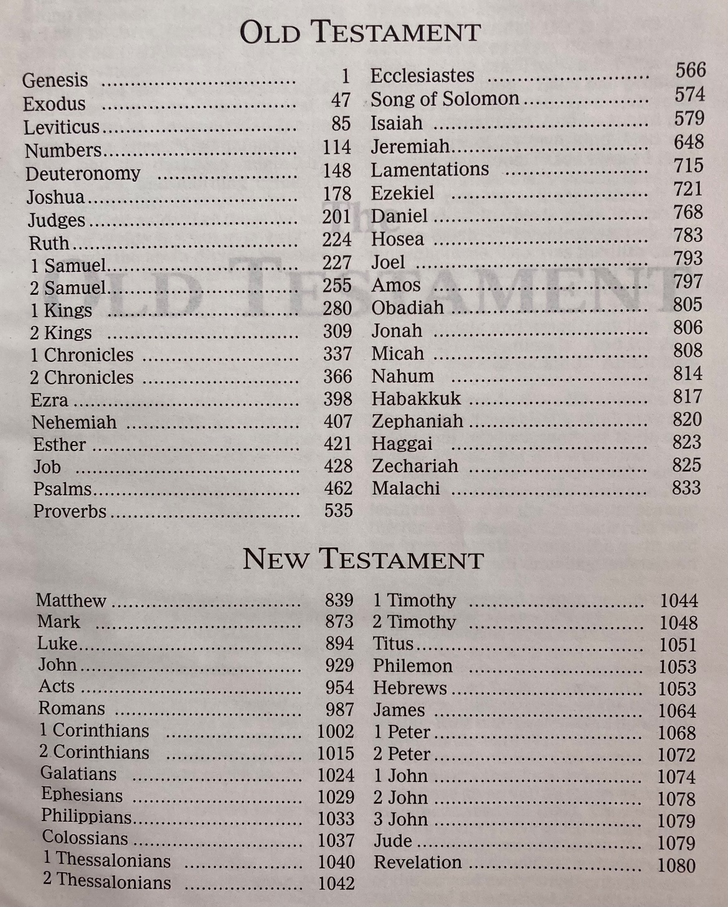

Slide 19
Approaching Easter Week 3 PAUSE Matthew Ch.26:69-75 and Ch.27:11-26

Slide 20
Now Peter was sitting out in the courtyard, and a servant girl came to him. “You also were with Jesus of Galilee,” she said. But he denied it before them all. “I don’t know what you’re talking about,” he said. Then he went out to the gateway, where another servant girl saw him and said to the people there, “This fellow was with Jesus of Nazareth.” He denied it again, with an oath: “I don’t know the man!” After a little while, those standing there went up to Peter and said, “Surely you are one of them; your accent gives you away.” Then he began to call down curses, and he swore to them, “I don’t know the man!” Immediately a rooster crowed. Then Peter remembered the word Jesus had spoken: “Before the rooster crows, you will disown me three times.” And he went outside and wept bitterly. Matthew Ch.26:69-75 (NIV)

Slide 21
Meanwhile Jesus stood before the governor, and the governor asked him, “Are you the king of the Jews?” “You have said so,” Jesus replied. When he was accused by the chief priests and the elders, he gave no answer. Then Pilate asked him, “Don’t you hear the testimony they are bringing against you?” But Jesus made no reply, not even to a single charge—to the great amazement of the governor. Now it was the governor’s custom at the festival to release a prisoner chosen by the crowd. At that time they had a well-known prisoner whose name was Jesus Barabbas. So when the crowd had gathered, Pilate asked them, “Which one do you want me to release to you: Jesus Barabbas, or Jesus who is called the Messiah?” For he knew it was out of self-interest that they had handed Jesus over to him. While Pilate was sitting on the judge’s seat, his wife sent him this message: “Don’t have anything to do with that innocent man, for I have suffered a great deal today in a dream because of him.” But the chief priests and the elders persuaded the crowd to ask for Barabbas and to have Jesus executed. Matthew Ch.27:11-26 (NIV)

Slide 22
“Which of the two do you want me to release to you?” asked the governor. “Barabbas,” they answered. “What shall I do, then, with Jesus who is called the Messiah?” Pilate asked. They all answered, “Crucify him!” “Why? What crime has he committed?” asked Pilate. But they shouted all the louder, “Crucify him!” When Pilate saw that he was getting nowhere, but that instead an uproar was starting, he took water and washed his hands in front of the crowd. “I am innocent of this man’s blood,” he said. “It is your responsibility!” All the people answered, “His blood is on us and on our children!” Then he released Barabbas to them. But he had Jesus flogged, and handed him over to be crucified. Matthew Ch.27:11-26 cont.

Slide 23
Approaching Easter Week 4 PAUSE Matthew Ch.27:27-56 - Jesus is mocked, carries the cross, and is crucified

Slide 24
https://www.positivityblog.com/10-inspirational-quotes-on-forgiveness
“Always forgive your enemies – nothing annoys them so much.”
Oscar Wilde
“Forgiveness does not change the past, but it does enlarge the future.”
Paul Boose
“Most of us can forgive and forget; we just don't want the other person to forget that we forgave.”
Ivern Ball
“True forgiveness is when you can say, “Thank you for that experience.”
Oprah Winfrey
“The stupid neither forgive nor forget; the naive forgive and forget; the wise forgive but do not forget.”
Thomas Szasz
“The weak can never forgive. Forgiveness is the attribute of the strong.”
Mahatma Gandhi
“Forgiveness is a gift you give yourself.”
Tony Robbins

Slide 25
Approaching Easter Week 5 PAUSE Matthew Ch.27:57-66 and Ch.28:1-20

Slide 26
https://www.youtube.com/watch?v=9u7V-g_cJaU

Slide 27
Approaching Easter Week 5 FAST FORWARD Sharing can be a struggle

Slide 28
‘You must go to people in every country of the world. Teach them to become my disciples.’ ‘You can be sure that I will be with you always.’ Matthew Ch.28:19-20

