Slide 1
CHRISTMAS ANAGRAM QUIZ

Slide 2
A Christmas school play | TINYVITA
Where they laid the baby | NGAMER
Send them to friends this December | RDSAC
It makes a white Christmas | WNOS
The reason for the season! | SEJUS
For dinner on 25 December | EKRTUY
Say it to everyone you meet | RYMER TRICHSAMS
Jesus’ mother | ARMY

Slide 3
A Christmas school play | TINYVITA | NATIVITY
Where they laid the baby | NGAMER | MANGER
Send them to friends this December | RDSAC | CARDS
It makes a white Christmas | WNOS | SNOW
The reason for the season! | SEJUS | JESUS
For dinner on 25 December | EKRTUY | TURKEY
Say it to everyone you meet | RYMER TRICHSAMS | MERRY CHRISTMAS
Jesus’ mother | ARMY | MARY

Slide 4
NATIVITY SPOT THE DIFFERENCE Can you spot ten differences?

Slide 5
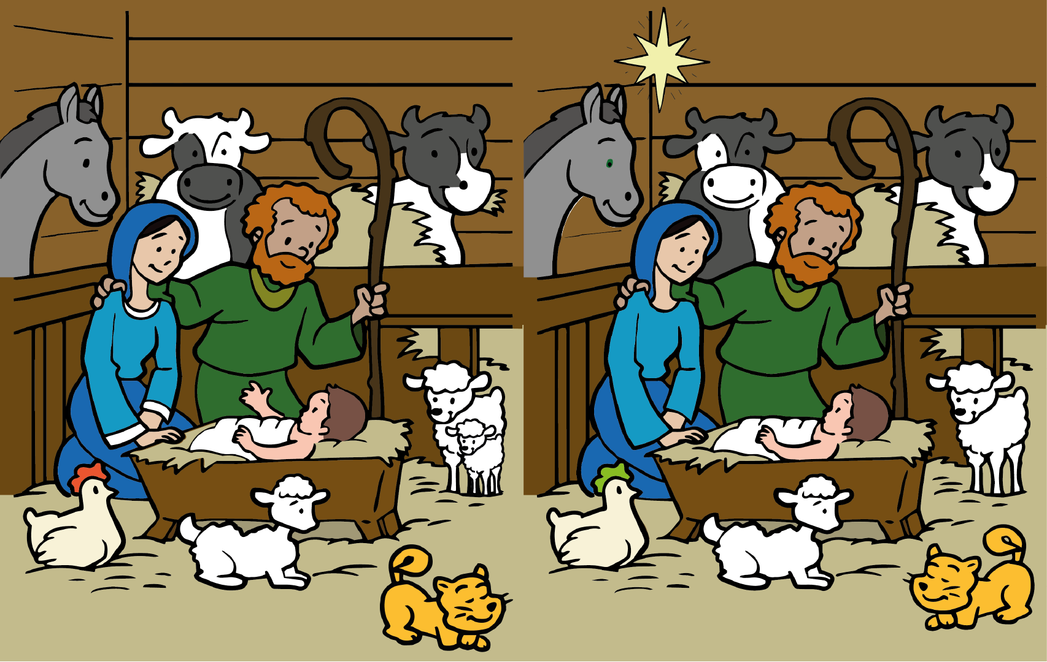

Slide 6
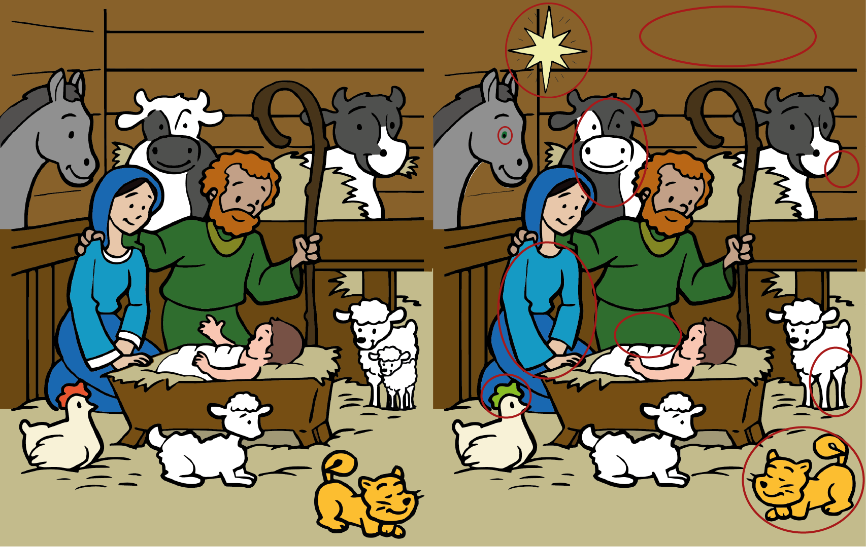

Slide 7
CHRISTMAS WORDSEARCH

Slide 8
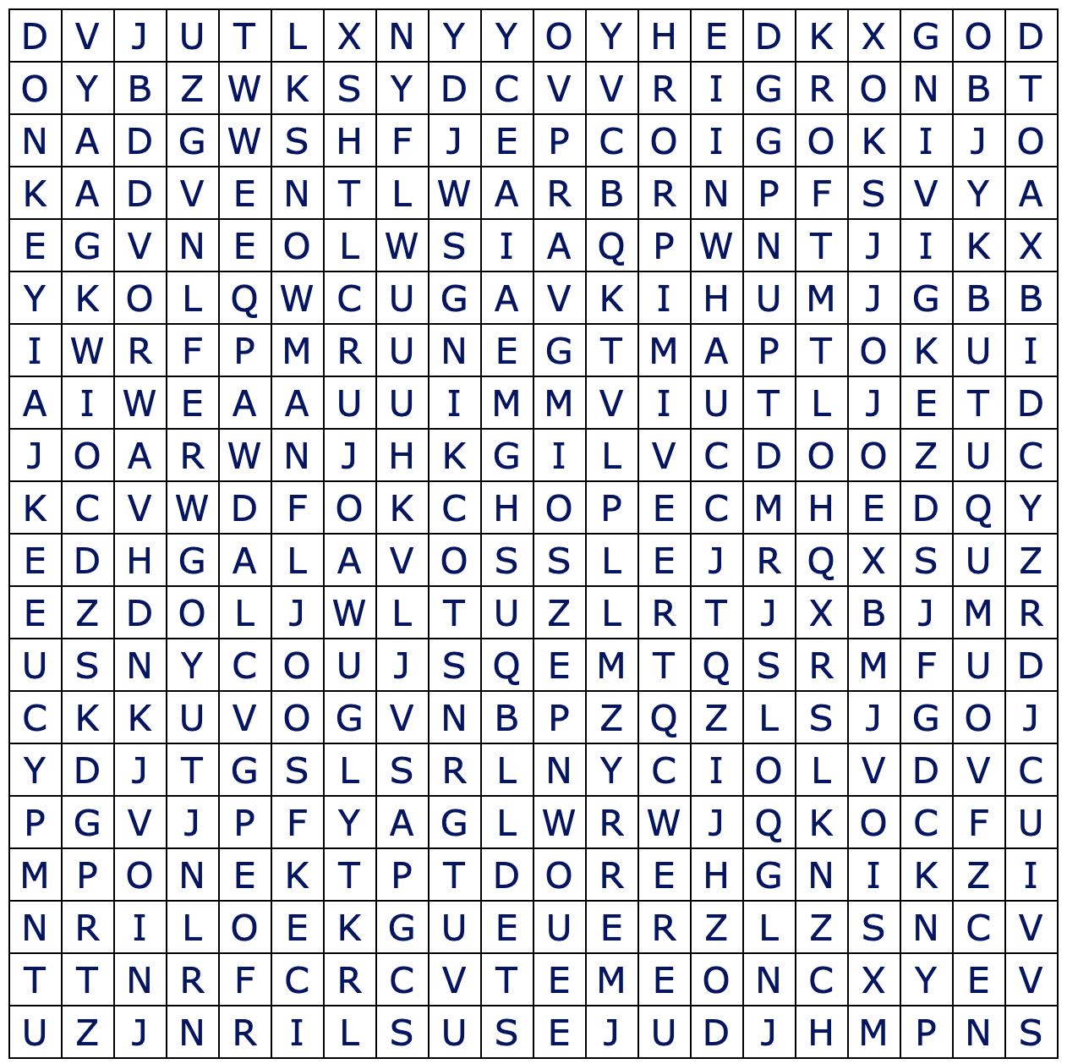
HOPE
RUDOLPH
ADVENT
CHOCOLATE
GIVING
PEACE
SNOWMAN
TREE
MERRY
CELEBRATE
HOLLY
STOCKINGS
JESUS
DONKEY
KING HEROD

Slide 9
CHRISTMAS JUMPER DECORATING

Slide 10
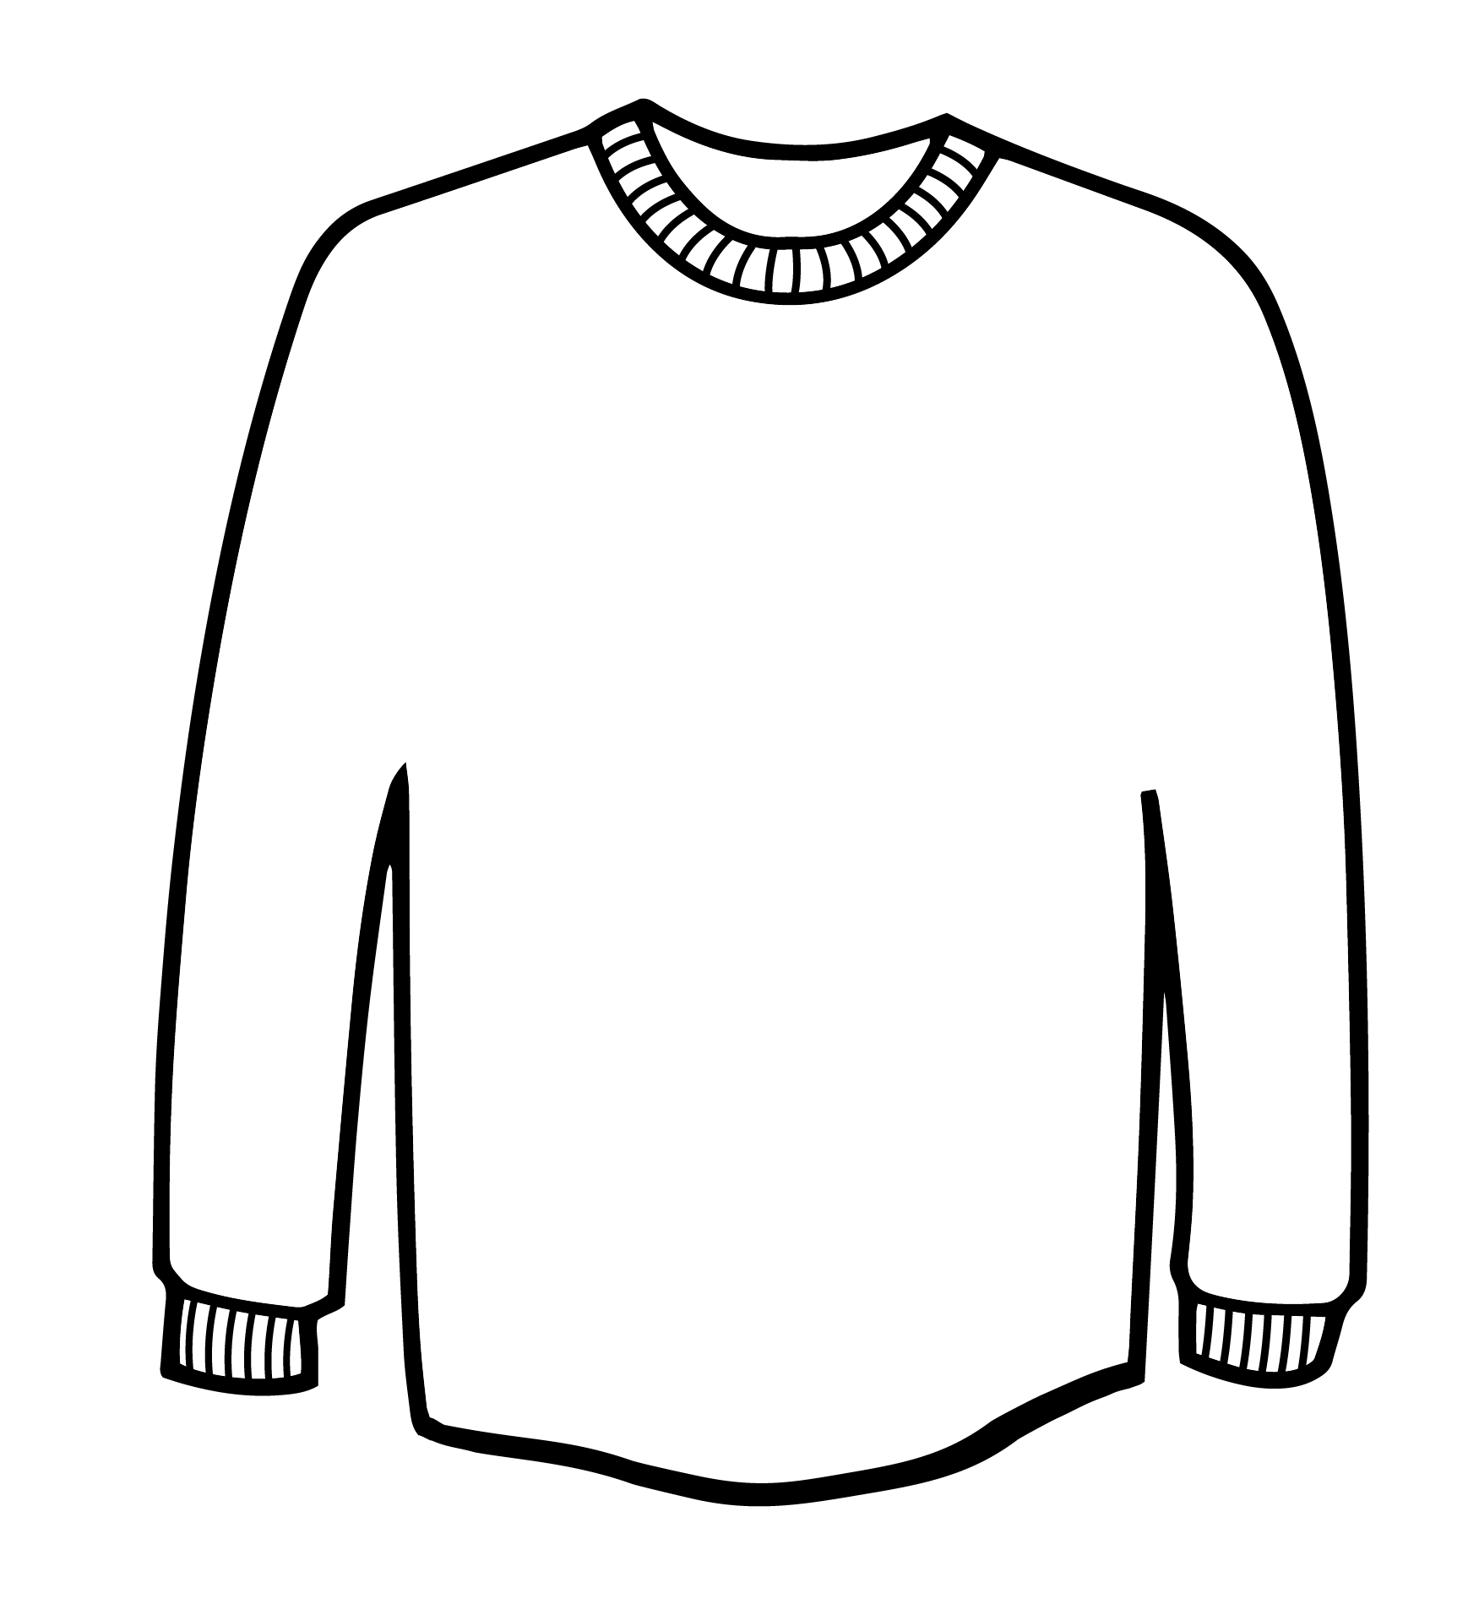
Use this template to design the best
Christmas jumper

Slide 11
CHRISTMAS SCAVENGER HUNT

Slide 12
Something red | A hat
A bow | Something you could give as a gift
Something you would find in a nativity scene | Something sparkly
A candle | Father Christmas
Something cold | Something warm
A Christmas decoration | Something fluffy
Something green | Some Christmas themed clothing
Chocolate | Something you would like to receive at Christmas

Slide 13
The activities above can be used during a single session or distributed to young people and their families to complete in their own time – you might even wish to make it into a challenge or competition with prizes!
The whiteboard function on Zoom is a great way to make this PowerPoint interactive to get the young people to fill in answers on the screen. Activities such as Christmas-themed hangman and Christmas-themed Pictionary are also great time-fillers to play on the Whiteboard function.

